Slide 1

EE272 Digital Systems Fall 2019
Instructor: Dr. Aashir Waleed
Lecture 2 – 1
Chapter 2
Boolean Algebra & Logic Gates

Slide 2
Lecture Overview
Lecture 2 – 2
 Boolean Algebra
 Boolean Functions
 Logic Gates
 Implementing Boolean Functions using Logic Gates
 Canonical and Standard Forms
 Inside logic gates
 TTL and CMOS logic
 Electrical characteristics: Signal levels, Noise margins, Fan- out, Speed
 Reading assignment: Chapter 2.1 to 2.8

Slide 3

Logic function
Lecture 2 – 3
 Digital system works on binary number which has only two elements, ‘0’, and ‘1’
 Need circuits to manipulate 1’s and 0’s, they are called logic function
A
B C
F
Y
 A,B, C,Y – logic variables (binary signals)
 A, B,C – inputs
 Y – output
 Logic function:Y = F(A,B,C)

Slide 4
Truth Table
Lecture 2 – 4
 Tabulate all possible input combinations of the variables
 Showing the relation between the values that the variables may take and the result of the operation
 E.g.
How can we design a circuit that implement a certain function specified by a truth table?
A | B | C | Y
0 | 0 | 0 | 1
0 | 0 | 1 | 1
0 | 1 | 0 | 0
0 | 1 | 1 | 1
1 | 0 | 0 | 0
1 | 0 | 1 | 1
1 | 1 | 0 | 1
1 | 1 | 1 | 0

Slide 5

Boolean Algebra
Lecture 2 – 5
 In 1854, a mathematician, George Boole, in a book called “An Investigation of the Laws of Thought, on Which are Founded the Mathematical Theories of Logic an Probabilities” developed an algebraic system to handle only two variables,TRUE and FALSE

Slide 6
Structure of Boolean Algebra
Lecture 2 – 6
 a set of elements B
 Two binary operations
 One unary operation
{AND, OR} → { •, + }
{NOT} → { ' }
 Axioms (Huntington Postulates)
 1. Set B contains at least two elements, a, b, such that a ≠ b
 consider a two valued Boolean algebra, i.e. B = {0,1}
 2. Closure (with respect to the Binary operator +, •):
 (i) a + b is in B (ii) a • b is in B
 3. Commutative Laws:
 (i) a + b = b + a (ii) a • b = b • a
 4. Identity elements with respect to the Binary operator: 0, 1 in B
 (i) a + 0 = a
 5. Distributive Laws:
 (i) a + (b • c) = (a + b) • (a + c)
 6. Complement:
 (i) a + a' = 1
(ii) a • 1 = a
(ii) a • (b + c) = a • b + a • c
(ii) a • a' = 0

Slide 7
Laws of Boolean Algebra
Lecture 2 – 7
 Duality:
 A dual of a Boolean expression is derived by interchanging OR and AND operations, and 0s and 1s (literals are left unchanged)
 Any law that is true for an expression is also true for its dual.
 Theorems of Boolean Algebra derived from postulates
 Operations with 0 and 1:
 x + 1 = 1
 Idempotent:
 x + x = x
 Involution:
 (x’)’ = x
 De Morgan:
 (x + y)’ = x’ y’
 Absorption:
 x + xy = x
 Associative:
 (x + y) + z = x + (y + z)
x 0 = 0
x x = x
(x y)’ = x’ + y’
x (x + y) = x
(x y) z = x (y z)

Slide 8
Proving Theorems via axioms of Boolean Algebra
Lecture 2 – 8
 Theorems can be proved (derived) by axioms
 Example 1: prove the simplification theorem: x y + x y’ = x
 x y + x y’ | = x (y + y’) | distributive law
 x (y + y’) | = x (1) | complementary law
 x (1) | = x | identity
 Example 2: prove the Simplification theorem: x + x y = x
 x + x y  x 1 + x y | = x 1 + x y = x (1 + y) | identity distributive law
 x (1 + y) | = x (1) | identity
 x (1) | = x | identity
 In theory, simplification should be done by these laws
 In practice, graphic method is used for convenience
 How does these Boolean Algebra relate to digital design?

Slide 9
Laws of Boolean Algebra (Cont.)
Lecture 2 – 9
 Distributive Laws:
 x (y + z) = (x y) + (x z)
 “Simplification” Theorems:
 x y + x y’ = x
x (y + y’) = x 1 = x
Since y + y’ = 1
 x + x y = x
x(1 + y) = x
Since 1 + y = 1
 (x + y’) y = x y
xy + y’y = xy since y’y = 0
 DeMorgan’s Law:
 (x + y + z + …)’ = x’ y’ z’
x +(y z) = (x + y)(x + z)
(x + y) (x + y’) = x
x x + x y’ + yx + yy’ = x (1 + y’ + y) = x Since x x = x and yy’ = 0 also 1 + y’ + y = 1
x (x + y) = x
x x + x y = x (1 + y) = x
(x y’) + y = x + y
(x + y ) (y’ + y) = x + y since y’ + y =1
(x y z …)’ = x’ + y’ + z’ + …

Slide 10
More example on DeMorgan’s Law
Lecture 2 – 10
 Complement of a Function
 F= (A+B+C)’ = (A+x)’ where x = B+C
 => F = A’x’
 => F= A’(B+C)’
 => F = A’(B’C’) = A’B’C’
 We can generalize F = (A+B+C+…+Z)’=A’B’C’…Z’
 Similarly
 F=(ABC)’=(Ax)’ where x = BC
 =>F=A’+x’
 =>F = A’+(BC)’
 =>F = A’+B’+C’
 And we have F = (ABC…Z)’ = A’+B’+C’+…+Z’

Slide 11
 Theorems for Multiplying and Factoring:
Lecture 2 – 11
 (x + y) (x’ + z) = x z + x’ y
 x x’ + x z + y x’ + y z = x z + x’ y
 x z + y x’ + y z = x z + x’ y since x x’ = 0
 x z + y x’ + y z ( x + x’) = x z + x’ y since x + x’ = 1 and y z 1 = y z
 x z + y x’ + y z x + y z x’ = x z + x’ y
 x z (1 + y) + y x ‘ (1 + z ) = x z + x’ y
 x z 1 + y x’ 1 = x z + x’ y since 1 + y = 1 and 1 + z = 1
 x y + x’ z = (x + z) (x’ + y)
 (x y + x’ ) (x y + z) = (x + z) (x’ + y)
 (x + x’)(y + x’)(x + z)(y + z) = (x + z)(x’ + y)
 (y + x’)(x + z)(y + z + x x’) = (x + z)(x’ + y) since x + x’ = 1 and x x’ = 0
 (y + x’)(x + z)(y + z + x)(y + z + x’) = (x + z)(x’ + y)
 [(y + x’)(y + x’) + z (y + x’)][(x + z)(x + z) + (x + z) y ] = (x + z)(x’ + y)
 [(y + x’)(1 + z)][(x + z)(1 + y)] = (x + z)(x’ + y) since 1 + z = 1 and 1 + y = 1

Slide 12
 Consensus Theorem:
Lecture 2 – 12
 x y + y z + x’ z = x y + x’ z
 Proof?
 (x + y) (y + z) (x’ + z) = (x + y) (x’ + z)
 Proof?

Slide 13
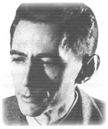
Digital Logic Circuits
Lecture 2 – 13
 In 1938, Claude Shannon (father of information theory) showed (in his Master’s thesis!) how to map Boolean Algebra to digital circuits (using electromechanical relays)
 to optimize arrangements of telephone routing switches using laws of Boolean Algebra
 to use arrangements of switches to solve logic problems
 Today we use the same principles, but replace electromechanical relays with logic gates (made of transistors).

Slide 14
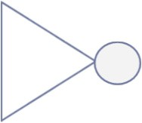


Two-valued Boolean Algebra and Basic Logic gates
 B = {0,1}
 Two binary operators + (OR), . (AND)
 Complementary operator (‘)
Not gate (inverter)
AND gate
OR gate
A | B | Y=A.B
0 | 0 | 0
0 | 1 | 0
1 | 0 | 0
1 | 1 | 1
A | B | Y=A+B
0 | 0 | 0
0 | 1 | 1
1 | 0 | 1
1 | 1 | 1
A | Y = A’
0 | 1
1 | 0
INVERTER
AND
OR

Slide 15


Example: three-input function
Lecture 2 – 15
 Logic Function: F = x.(y+z)
 Truth table Circuits (Schematic diagram)
x | y | z | (y+z) | F=x.(y+z)
0 | 0 | 0 | 0 | 0
0 | 0 | 1 | 1 | 0
0 | 1 | 0 | 1 | 0
0 | 1 | 1 | 1 | 0
1 | 0 | 0 | 0 | 0
1 | 0 | 1 | 1 | 1
1 | 1 | 0 | 1 | 1
1 | 1 | 1 | 1 | 1
y z
F
x
Literal – a single variable within a term (complemented or un- complemented). For example: x, y, z are all literals

Slide 16
Generalization to any function (gate)
Lecture 2 – 16
ANY gate Y₀, Y₁, Y₂, Y₃ assumes either 0 or 1
To generalize, we define “minterms” and “maxterms”
Minterms are PRODUCT terms
Maxterms are SUM terms
A | B | Y = ?
0 | 0 | Y₀
0 | 1 | Y₁
1 | 0 | Y₂
1 | 1 | Y₃
A | B | Y | Minterms
0 | 0 | Y₀ | A’ B’
0 | 1 | Y₁ | A’ B
1 | 0 | Y₂ | A B’
1 | 1 | Y₃ | A B
A | B | Y | Maxterms
0 | 0 | Y₀ | A + B
0 | 1 | Y₁ | A + B’
1 | 0 | Y₂ | A’ + B
1 | 1 | Y₃ | A’ + B’

Slide 17
Generalization by using MINTERMS
Lecture 2 – 17
A | B | Y | Minterms
0 | 0 | Y₀ | A’ B’
0 | 1 | Y₁ | A’ B
1 | 0 | Y₂ | A B’
1 | 1 | Y₃ | A B
Y = Y₀A’B’ + Y₁A’B + Y₂AB’ + Y₃AB
This is also known as the SUM of PRODUCTS (SOP) form of the function Y
Let’s put to test on AND and OR gates
AND gate
Y = 0 A’B’ + 0 A’B + 0 AB’ + 1 AB = AB
A | B | Y=A.B
0 | 0 | 0
0 | 1 | 0
1 | 0 | 0
1 | 1 | 1
OR gate
Y = 0 A’B’ + 1 A’B + 1 AB’ + 1 AB
= A’B + AB’ + AB
A | B | Y=A+B
0 | 0 | 0
0 | 1 | 1
1 | 0 | 1
1 | 1 | 1
Does this look like OR gate?
How about after further simplification:
= A’B + AB’ + AB + AB
= B (A’ + A) + A (B’ + B)
= A + B

Slide 18
Further notation on MINTERMS (Σm):
Lecture 2 – 18
A | B | Y | Minterms
0 | 0 | Y₀ | m₀=A’ B’
0 | 1 | Y₁ | m₁=A’ B
1 | 0 | Y₂ | m₂=A B’
1 | 1 | Y₃ | m₃=A B
Y = Y₀A’B’ + Y₁A’B + Y₂AB’ + Y₃AB
This is also known as the SUM of PRODUCTS (SOP) form of the function Y
Let’s put to test on AND and OR gates
AND gate
Y = AB =Σm(3) = m₃
A | B | Y=A.B
0 | 0 | 0
0 | 1 | 0
1 | 0 | 0
1 | 1 | 1
OR gate
Y = A’B + AB’ + AB
= Σm(1,2,3) = m₁ + m₂ + m₃
Does this look like OR gate?
How about after further simplification:
= A’B + AB’ + AB + AB
= B (A’ + A) + A (B’ + B)
= A + B
A | B | Y=A+B
0 | 0 | 0
0 | 1 | 1
1 | 0 | 1
1 | 1 | 1

Slide 19
Generalization by using MAXTERMS
Lecture 2 – 19
Y = (Y₀+A+B)(Y₁+A+B’)(Y₂+A’+B)(Y₃+A’+B’)
This is also known as the PRODUCT of SUMS (POS) form of the function Y
Let’s put to test on AND and OR gates
A | B | Y | Maxterms
0 | 0 | Y₀ | A + B
0 | 1 | Y₁ | A + B’
1 | 0 | Y₂ | A’ + B
1 | 1 | Y₃ | A’ + B’
OR gate
Y = (0+A+B)(1+A+B’)(1+A’+B)(1+A’+B’) = A + B
A | B | Y=A+B
0 | 0 | 0
0 | 1 | 1
1 | 0 | 1
1 | 1 | 1
AND gate ^{Y}
= (0+A+B)(0+A+B’)(0+A’+B)(1+A’+B’)
= (A + B)(A + B’)(A’ + B)
Does this look like OR gate?
How about after further simplification:
=(AA + AB’ + BA + BB’)(A’ + B)
=A(1 + B’ + B)(A’ + B) since AA = A and BB’=0
=AA’+AB since AA’ = 0
=AB
A | B | Y=A.B
0 | 0 | 0
0 | 1 | 0
1 | 0 | 0
1 | 1 | 1

Slide 20
Further notation on MAXTERMS (ΠM):
Lecture 2 – 20
Y = (Y₀+A+B)(Y₁+A+B’)(Y₂+A’+B)(Y₃+A’+B’)
This is also known as the PRODUCT of SUMS (POS) form of the function Y
Let’s put to test on AND and OR gates
A | B | Y | Maxterms
0 | 0 | Y₀ | M₀ =A + B
0 | 1 | Y₁ | M₁ =A + B’
1 | 0 | Y₂ | M₂ = A’ + B
1 | 1 | Y₃ | M₃ = A’ + B’
OR gate
Y = A + B = ΠM(0) = M₀
A | B | Y=A+B
0 | 0 | 0
0 | 1 | 1
1 | 0 | 1
1 | 1 | 1
AND gate ^{Y}
= (A + B)(A + B’)(A’ + B)
= ΠM(0,1,2) = M₀
M₁ M₂
A | B | Y=A.B
0 | 0 | 0
0 | 1 | 0
1 | 0 | 0
1 | 1 | 1
Does this look like OR gate?
How about after further simplification:
=(AA + AB’ + BA + BB’)(A’ + B)
=A(1 + B’ + B)(A’ + B) since AA = A and BB’=0
=AA’+AB since AA’ = 0
=AB

Slide 21
Apply to previous Example: F = x (y + z)
 SOP: F = Σ m(5,6,7) = m₅ + m₆ + m₇ = x y’ z + x y z’ + x y z
 POS: F = Π M(0,1,2,3,4) = M₀ M₁ M₂ M₃ M₄

= (x + y + z)(x + y + z’)(x + y’ + z)(x + y’ + z’)(x’ + y + z)
x | y | z | (y+z) | F = x.(y+z) | Minterms | Maxterms
0 | 0 | 0 | 0 | 0 | m₀ = x’ y’ z’ | M₀ = x + y + z
0 | 0 | 1 | 1 | 0 | m₁ = x’ y’ z | M₁ = x + y + z’
0 | 1 | 0 | 1 | 0 | m₂ = x’ y z’ | M₂ = x + y’ + z
0 | 1 | 1 | 1 | 0 | m₃ = x’ y z | M₃ = x + y’ + z’
1 | 0 | 0 | 0 | 0 | m₄ = x y’ z’ | M₄ = x’ + y + z
1 | 0 | 1 | 1 | 1 | m₅ = x y’ z | M₅ = x’ + y + z’
1 | 1 | 0 | 1 | 1 | m₆ = x y z’ | M₆ = x’ + y’ + z
1 | 1 | 1 | 1 | 1 | m₇ = x y z | M₇ = x’ + y’ + z’

Slide 22
Apply to previous Example: F = x (y + z)
 SOP: F = Σ m(5,6,7) = m₅ + m₆ + m₇ = x y’ z + x y z’ + x y z
 Show that if you simplify SOP you get x (y + z)???
 ….
 POS: F = Π M(0,1,2,3,4) = M₀ M₁ M₂ M₃ M₄

= (x + y + z)(x + y + z’)(x + y’ + z)(x + y’ + z’)(x’ + y + z)
Show that if you simplify POS, you get x (y + z)???
…

Slide 23
Minterms/Maxterms complement each other
Lecture 2 – 23
x | y | z | Minterms | Maxterms
0 | 0 | 0 | m₀ = x’ y’ z’ | M₀ = x + y + z
0 | 0 | 1 | m₁ = x’ y’ z | M₁ = x + y + z’
0 | 1 | 0 | m₂ = x’ y z’ | M₂ = x + y’ + z
0 | 1 | 1 | m₃ = x’ y z | M₃ = x + y’ + z’
1 | 0 | 0 | m₄ = x y’ z’ | M₄ = x’ + y + z
1 | 0 | 1 | m₅ = x y’ z | M₅ = x’ + y + z’
1 | 1 | 0 | m₆ = x y z’ | M₆ = x’ + y’ + z
1 | 1 | 1 | m₇ = x y z | M₇ = x’ + y’ + z’
One can be derived from the other by applying DeMorgan’s Law Example:
m₅ = x y’ z ➔ M₅ = m₅’ = [x y‘z]’= x’+ y + z’
M₂ = x + y’+ z ➔ m₂ = M₂’ = [x + y’+ z]’= x’ y z’

Slide 24
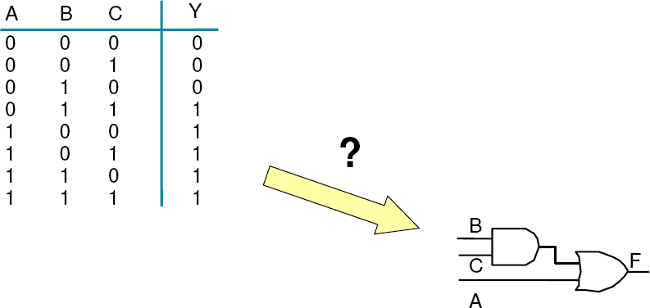
How to go from specification (truth table) to circuits?
 Get the truth table and SOP or POS from truth table
 Carry out logic minimization
 We will look into how we can do it systematically
 Then map the logic expression with gate.

Slide 25
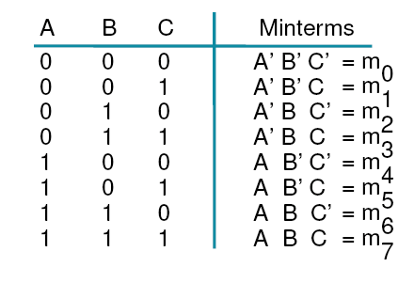
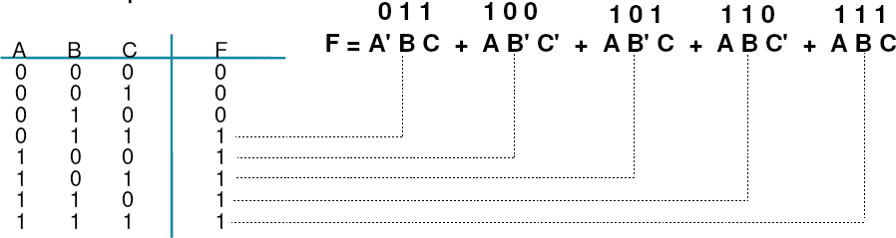
Lecture 2 – 25
Sum of Product (Minterm expansion)
Example
F(A,B,C) = ∑m(3,4,5,6,7) = m3 + m4 + m5 + m6 + m7

Slide 26
SOP minimization and gate implementation
Lecture 2 – 26
 A function might have many alternative Boolean expressions
 But only one minimized Boolean expression
F = A’BC + AB’C’ + AB’C + ABC’ + ABC
= A B' (C + C') + A' B C + A B (C' + C)
= A B' + A' B C + A B
= A (B' + B) + A' B C
= A + A' B C
= A + B C
B
C
F
A

Slide 27
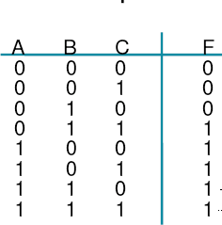
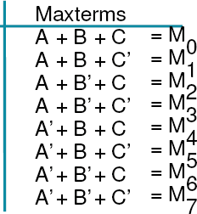
Lecture 2 – 27
Product of Sum (Maxterm expansion)
F(A, B, C) =∏M (0,1, 2) = (A + B + C)(A + B + C ')(A + B '+ C)
Then POS minimization and gate implementation Show that the minimized form: F = (A+B) (A+C)

Slide 28
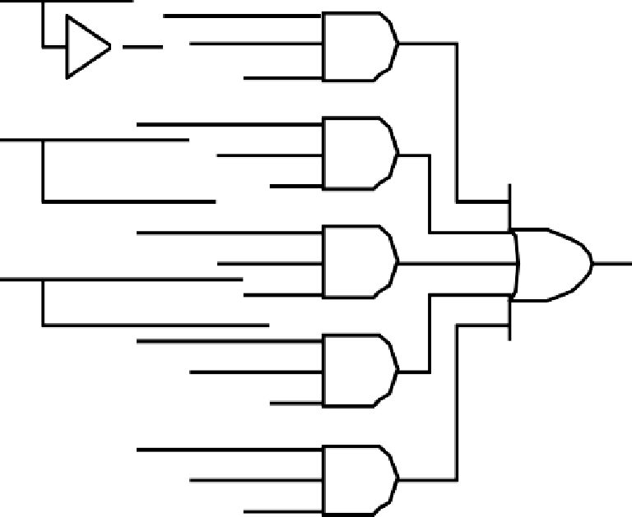
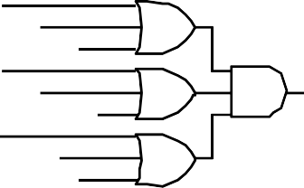
Summary
Lecture 2 – 28
 Four Alternative Implementations of F =Σm(3,4,5,6,7) :
A
Canonical Sum of Minterms
F₁ = A' B C + A B' C' + A B' C
+ A B C' + A B C
B
F₁
C
Minimized Sum of Minterms F₂ = A + BC
Canonical Products of Maxterms
F₃ = (A+B+C) (A+B+C') (A+B'+C)
Minimized Products of Maxterms F₄ = (A+B) (A+C)
F₂
F₃
F₄

Slide 29
Summary
Lecture 2 – 29
 Truth table and Boolean expression
 Truth table is the unique signature of a Boolean function
 Many alternative expressions (gate realizations) may have the same truth table
 Canonical form: Standard form for a Boolean expression
 Provides a unique algebraic signature because it derives from the truth table
 Either presented in SOP or POS form
 All the terms in SOP or POS must contain all the literals that the function depends on (because it’s Canonical)
 Leads to a two-level gate implementation (see the previous slide)
 Sum of Product (AND first, OR last)
 also known as minterm expansion
 Product of Sum (OR first,AND last)
 Also known as maxterm expansion

Slide 30

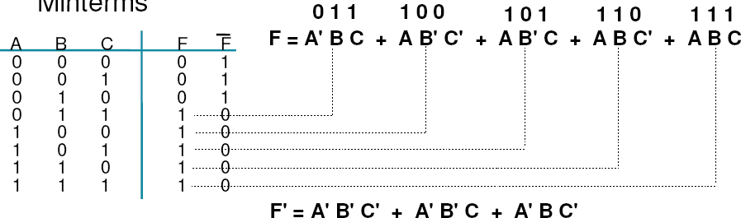
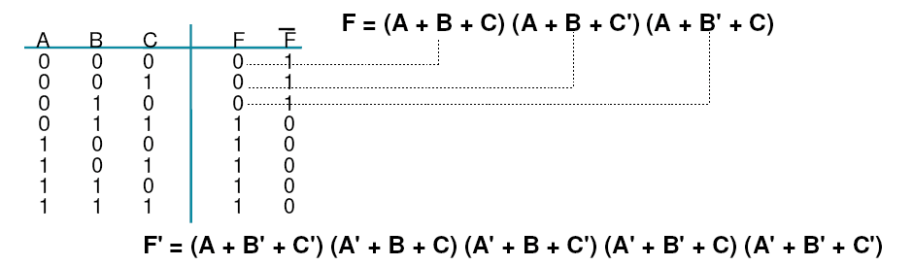
Two-Level Canonical Forms (SOP or POS)
Lecture 2 – 30
 Minterms
 Maxterms

Slide 31
Two-Level Canonical Forms (Cont’d)
Lecture 2 – 31
 From Maxterm to Minterms
 Express Complementary of F in Maxterms
 F' = (A + B' + C') (A' + B + C) (A' + B + C') (A' + B' + C) (A' + B' + C')
 Apply DeMorgan's Law to obtain F
 (F')' = {(A + B' + C') (A' + B + C) (A' + B + C') (A' + B' + C) (A' + B' + C')}’
 F = A' B C + A B' C' + A B' C + A B C' + A B C
 From Minterm to Maxterms
 Express Complementary of F in Minterms
 F' = A' B' C' + A' B' C + A' B C’
 Apply DeMorgan's Law to obtain F
 (F')' = (A' B' C' + A' B' C + A' B C')’
 F = (A + B + C) (A + B + C') (A + B' + C)

Slide 32
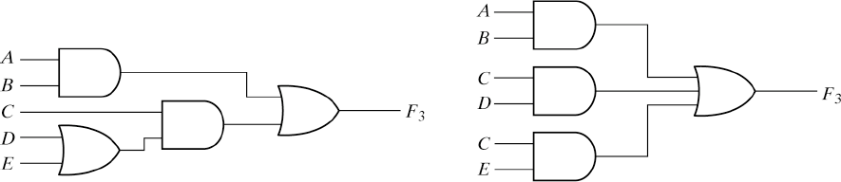
Logic circuits and Boolean expression
Lecture 2 – 32
 Same function can have different Boolean expression and hence different gate implementation
 Example: F = AB+C(D+E) = AB +CD +DE
 Same function F, but different expression and hence different gate implementation
F₃ = AB + CD + DE
F₃ = AB + C(D +E)
D

Slide 33
About Boolean Algebra
Lecture 2 – 33
 Boolean algebra provides a mathematical foundation for manipulating Boolean expressions. With Boolean algebra, we are able to simplify (or minimize or optimize) a Boolean expression, which leads to a simplified (or minimized or optimized) circuit
 In practice, we rarely do it by manual algebraic manipulation, but use other methods for simplifying Boolean expressions (next week!). For simple combinational logic, the most common method for simplifying Boolean expression is a Karnaugh Map (K-Map). For more complex and multi-level combinational logic, computer-aided-design (CAD) algorithms are used, e.g. Quine-McCluskey, Espresso, etc. Different applications use different algorithms.

Slide 34


Incompletely Specified Functions
Lecture 2 – 34
 A n-input functions have 2^{n} input combinations
 But for a given function, not all input combinations are specified
 Example, Binary Coded Decimal Digit Increment by 1
 BCD digits encode the decimal digits 0 - 9 in the bit patterns of 0000 - 1001
 6 out of 16 possible are not defined
A B C D W X Y Z
Off-set of W
0 | 0 | 0 | 0 | 0 | 0 | 0 | 1
0 | 0 | 0 | 1 | 0 | 0 | 1 | 0
0 | 0 | 1 | 0 | 0 | 0 | 1 | 1
0 | 0 | 1 | 1 | 0 | 1 | 0 | 0
0 | 1 | 0 | 0 | 0 | 1 | 0 | 1
0 | 1 | 0 | 1 | 0 | 1 | 1 | 0
0 | 1 | 1 | 0 | 0 | 1 | 1 | 1
0 | 1 | 1 | 1 | 1 | 0 | 0 | 0
1 | 0 | 0 | 0 | 1 | 0 | 0 | 1
1 | 0 | 0 | 1 | 0 | 0 | 0 | 0
1 | 0 | 1 | 0 | X | X | X | X
1 | 0 | 1 | 1 | X | X | X | X
1 | 1 | 0 | 0 | X | X | X | X
1 | 1 | 0 | 1 | X | X | X | X
1 | 1 | 1 | 0 | X | X | X | X
1 | 1 | 1 | 1 | X | X | X | X
On-set of W
Don't care (DC) set of W
These input patterns should never be encountered in practice
associated output values are "Don't Cares"

Slide 35
Incompletely Specified Functions
Lecture 2 – 35
 Canonical Representations of the BCD Increment by 1 Function:
 Minterms
 Z = m0 + m2 + m4 + m6 + m8 + d10 + d11 + d12 + d13 + d14 + d15
 Z = Σm(0, 2, 4, 6, 8) + d(10, 11, 12 ,13, 14, 15)
 W = Σm(7, 8) + d(10, 11, 12 ,13, 14, 15)
 X = Σm(3, 4, 5, 6) + d(10, 11, 12 ,13, 14, 15)
 Y = Σm(1, 2, 5, 6) + d(10, 11, 12 ,13, 14, 15)
 Maxterms
 Z = M1 • M3 • M5 • M7 • M9 • D10 • D11 • D12 • D13 • D14 • D15
 Z = ΠM(1, 3, 5, 7, 9) • D(10, 11, 12, 13, 14 ,15)
 W =
 X =
 Y =

Slide 36
More Logic Functions
Lecture 2 – 36
For a 2-input function, there are 2² = 4 input combinations
and 2⁴ = 16 output functions
 16 Boolean functions of two variables
 2 variables
 2 identities
X,Y
0, 1
 4 primitive functions X',Y', X•Y, X+Y
(AND, OR, NOT)
 2 CMOS building blocks
 2 equality/inequality gates
(X+Y)’, (X•Y)’ X⊕Y, (X⊕Y)’
(NAND, NOR) (XOR, XNOR)
 4 inhibition and implication function
(for comparison, too)
X | Y | F0 | F1 | F2 | F3 | F4 | F5 | F6 | F7 | F8 | F9 | F10 | F11 | F12 | F13 | F14 | F15
0 | 0 | 0 | 0 | 0 | 0 | 0 | 0 | 0 | 0 | 1 | 1 | 1 | 1 | 1 | 1 | 1 | 1
0 | 1 | 0 | 0 | 0 | 0 | 1 | 1 | 1 | 1 | 0 | 0 | 0 | 0 | 1 | 1 | 1 | 1
1 | 0 | 0 | 0 | 1 | 1 | 0 | 0 | 1 | 1 | 0 | 0 | 1 | 1 | 0 | 0 | 1 | 1
1 | 1 | 0 | 1 | 0 | 1 | 0 | 1 | 0 | 1 | 0 | 1 | 0 | 1 | 0 | 1 | 0 | 1
0 |  |  |  | X |  | Y |  |  | X+Y (X⊕Y)’ |  |  |  | X’ |  | (X • |  | Y)’ 1
X•Y
X⊕Y (X+Y)’ Y’

Slide 37
Logic Functions: XOR, XNOR
Lecture 2 – 37
XOR Gate:
Z=1 if X ≠ Y (inequality gate)
Z=1 if only X or Y = 1
» odd function
Gate symbol
X Y
Truth table
XNOR Gate:
Z=1 if X = Y (equality gate)
Z=1 if none or both X,Y=1
» even function
Gate symbol
Z
X Y
X | Y | Z Z
0 | 0 | 0
0 | 1 | 1
1 | 0 | 1
1 | 1 | 0
Truth table | X | Y | Z
 | 0 | 0 | 1
 | 0 | 1 | 0
 | 1 | 0 | 0
 | 1 | 1 | 1
Boolean expression
– X ⊕ Y = X Y' + X' Y
Boolean expression
– (X ⊕ Y)’ = XY + X' Y’

Slide 38
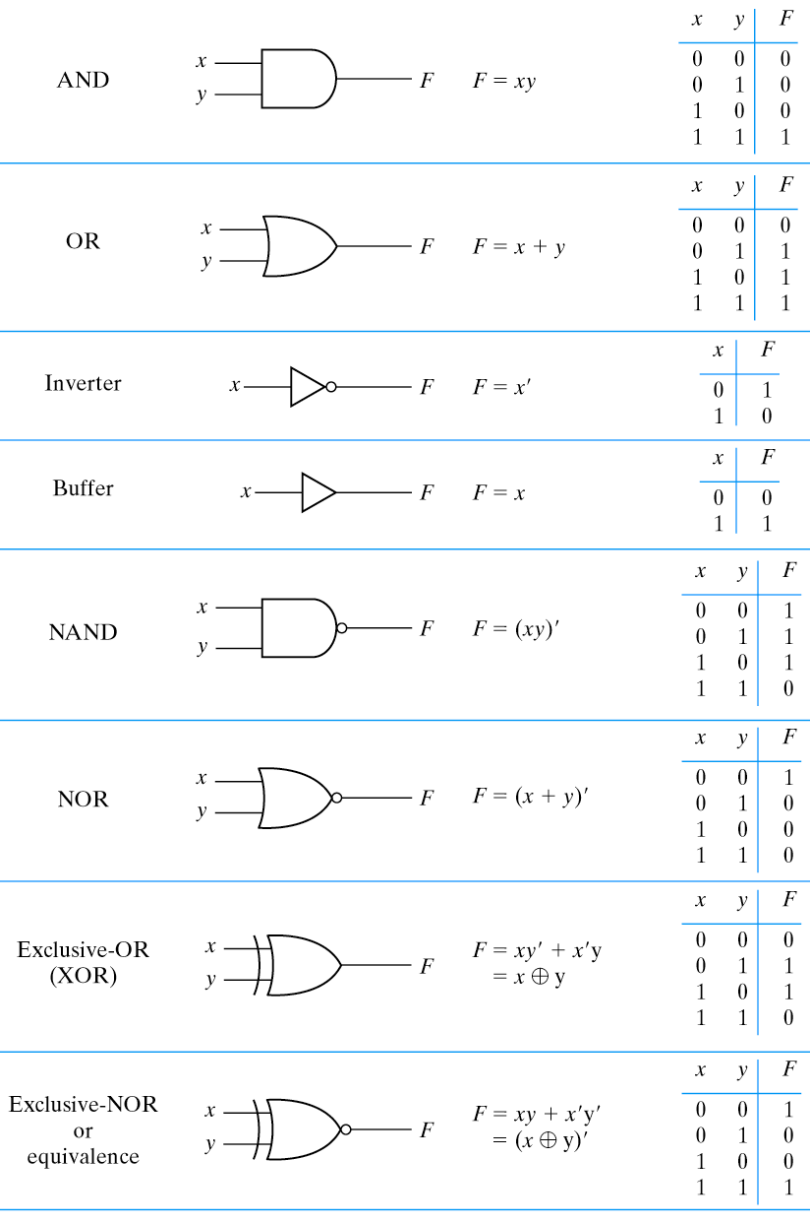
Common 2-input Logic Gates
Lecture 2 – 38

Slide 39
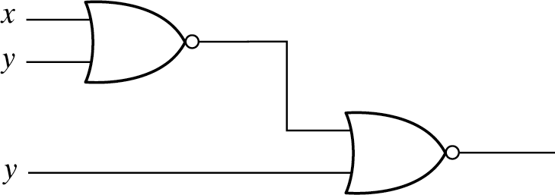
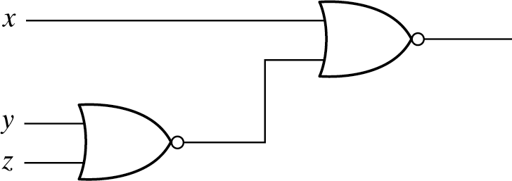



Lecture 2 – 39
2-input and 3-input Logic Gates
3-input OR gates could be made by 2 2-input OR gates
By associate law x + y + z = (x+y) + z = x + (y+z)
output equals to 1 if any input is 1
=
z
Could 3-input NOR gate be made by 2 2-input NOR gates?
Associate law applies to primitive gates, but not to NOR gates
– [(x+y)’+z]’ = (x+y) • z’ = xz’ + yz’ ≠ (x+y+z)’
output equals to 0 if any input is 1
≠
z

Slide 40
Sequence of designing a digital circuit given the logic function
 Design Sequence:
 1.Truth Table (input and output relations)
 Derive truth table from project specifications
 2. Boolean Expressions
 Derived from the truth table
 3.Logic Minimization
 Use Laws of Boolean Algebra to reduce the complexity of Boolean expressions while maintaining the same function
 2’ Graphic Method (K-Map) (Chapter 3)
 Re-express the truth table in graphs (K-Map)
 3’ Logic Minimization
 READ the simplified Boolean expressions from the graphs
 4. Digital Circuit
 Map the simplified Boolean expressions to digital circuits
 5. Waveforms
 CAD tool simulation and experiments

Slide 41
Lecture 2 – 41
Reading assignment
 Chapter 2.1 to 2.8 of textbook

